Slide 1
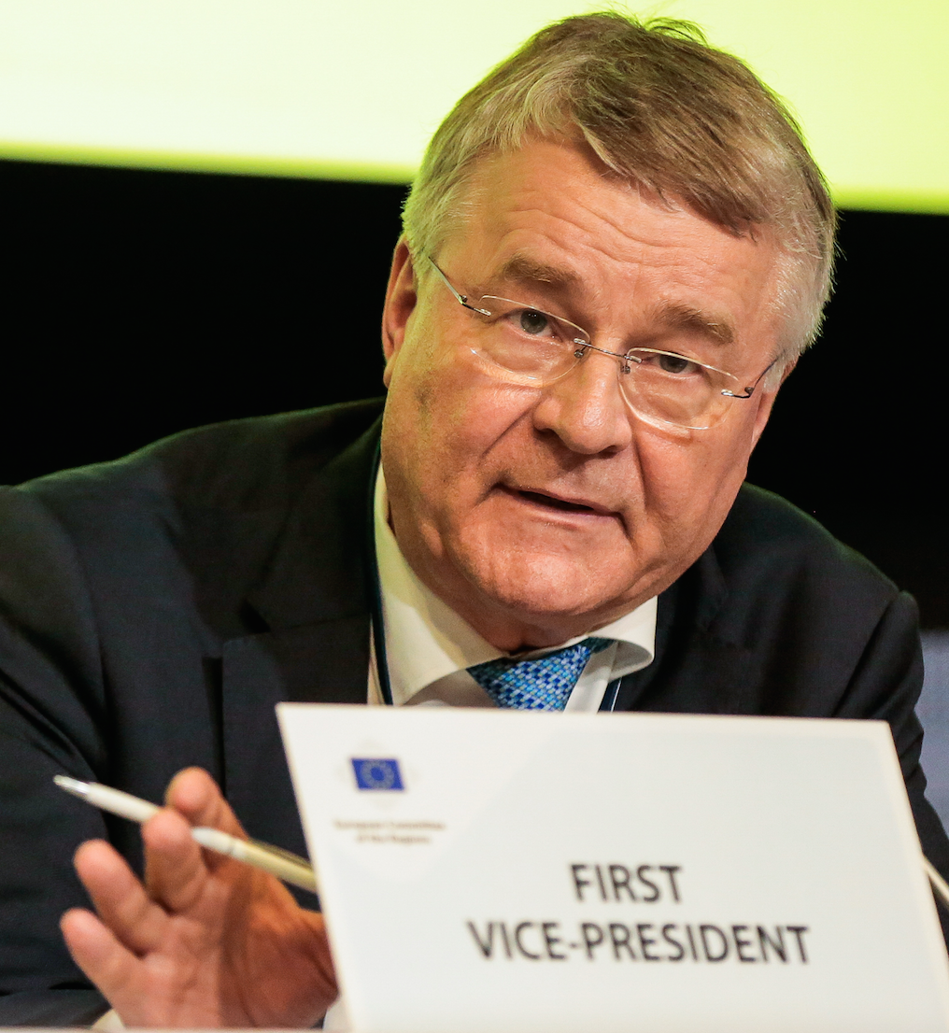
BSR Smartup
&
EU DIGITAL EUROPE
Tallinn 19 September 2018
Markku Markkula First Vice-President of the EU Committee
of the Regions CoR
COR RAPPORTEUR ON DIGITAL EUROPE
Chair of the Espoo City Board
President of the Helsinki Region
markku.markkula@aalto.fi

Slide 2
A Few Key Messages by the European Committee of the Regions CoR
Our leadership and management practices need to focus more on social and societal Innovation and research to be better linked to policy making by regions and cities.
In the regions, better science-society dialogue is needed in order to support the open society development.
Systemic networking, collaboration and multi-level governance in supporting the use of research knowledge and digitalization are vital for the success of sustainable growth and jobs creation in Europe.
Digital platforms are a necessary new tool for interaction, effective bench-learning and interaction to create synergies between different financing instruments to speed-up scaling of new innovations and practical change processes.
These platforms should be co-created through public-private-people partnership. Regions and cities need to attract more companies for wider scalability and impact.
Finally, most importantly: we need a new entrepreneurial mindset everywhere.

Slide 3
Digital in the next MFF: overview
Digital Europe:
Capacities & roll out
High Performance Computing (HPC)
Artificial Intelligence (AI)
Cybersecurity
Advanced digital skills
Digital transformation and interoperability
Digital in Horizon Europe
R&D&I
Digital under "global challenges"
Digital and industry cluster
Digital in other clusters - health, mobility, energy, environment,..
2. Open Innovation
3. Research Infra under Open Science
€9.2 billion
Connecting Europe Facility - Digital
Connectivity
5G roll out
BB 4EU, Connecting communities
Synergies with Transport /Energy
Creative Europe , MEDIA
€1.1 billion
Invest EU
Research, innovation & digitisation
ERDF/ Cohesion Fund
€3 billion
Notes:
Creative Europe MEDIA
Distribution of works
Creation
InvestEU
Research, innovation & digitisation - 11.2 EUR billion
Other programmes of note:
InvestEU
ERDF
Regional funds

Slide 4
Digital Europe programme – What?
Reinforcing digital capacities. Ensuring their best use.
Digital transformation
& Interoperability
€1.3 billion
€9.2 billion
in total
Advanced
digital skills
€0.7 billion
High performance
computing
Cybersecurity
& trust
€2.7 billion
Artificial
intelligence
€2 billion
€2.5 billion
#EUBudget
#DigitalEurope
Notes:
Why 9.2 Billion for the Digital Europe Programme? On what basis was the allocation made per pillar?
Based on assessment of needs (following EU programme spending review, market analysis reports, third party investments etc. cf Impact Assessment)
Cost of 2 exascale machines is close to €1 billion Euro. Networking and upgrading of mid-range computers in MSs requires a similar investment.
For example only a fifth of companies in the EU-28 are highly digitised, with great variety across Member States.
Establishing a quantum computing facility is a EUR 500 Million to EUR 1 billion investment.
Modest compared with main competitors (US, China)
For example total investments in HPC in the EU is at 60% of US level.
Likewise in AI, Europe invested USD 3 to 4 billion 2016, compared with USD 8 to 12 billion in Asia and USD 15 to 23 billion in North Marican.
In cybersecurity, While the cost of damage from cybersecurity attcks is expected to reach EUR 6 Tn in 2021, EU investment in advanced cybersecurity capacities remains modest. A recent study for the NL government estimates the total EU investments at close to 10 times less of the US investments.
China announced a programme for deploying quantum technologies with a focus on cybersecurity in the order of USD 10 Billion.
EU investments is not only low but also highly fragmented across MS.
Required to meet level of ambition.
Achievable only through co-investment.
Legal base:
172 TFEU Trans-European networks
173 TFEU (para 3) Industry policy – Conditions necessary for the competitiveness of the EU industry sector.
Joint Undertaking:
187 TFEU (Regulation establishing Digital Europe programme, COM(2018)434 final. Article 15).

Slide 5
Some examples
Modernisation of public administration
• By 2030: 450 million citizens and 24 million SMEs benefit from "Once Only Principle" for their administration information
By 2022, operate a public block chain infrastructure enabling cross-border public services serving as a catalyst for new innovative services developed by start-ups and SMEs
Multilingual services for public administrations
Services in areas of public interest
• By 2025: European eCard for all high education students
• Better internet for kids
Europeana and preserving Europe's Cultural Heritage
Digital health
• By 2022: 1 million sequenced genomes
• By 2027: 450 million citizens have access to health records,
100 million citizens have personalised health systems
• Data from 10 million citizens available for new discoveries
Digital Innovation Hubs
• 250 Hubs across the EU
• 90 experiments per hub
• Reaching ~42000 SMEs
Notes:
HPC – note slight amendments.
Two exascale machines by 2022/2023 (at least one with European technology) At least one post-exascale machine by 2027.

