Slide 1
Challenge № 1 Team № 1
How to increase citizen participation and promote co-creation to improve living environment and quality of life? Case of “Mustamäe” district, Tallinn.

Slide 2
Challenge
High mobility (people moving-in and out)
No sense of community
No identity of dorm areas
How to change “dormitory” area into leaving living area?
Underutilization of resources
No trust between neighboring people
Segregation of Russian-Estonian community
No explicit center
Lack of appreciation
Cultural integration issues of some parts of neighborhoods

Slide 3
Opportunities
Young families
Students
Plenty of green areas
Proximity of neighborhood to the nature
Safe area
Active online communities (Facebook groups)

Slide 4
Stakeholders
Local authorities
Businesses (malls, kiosks)
Proactive citizens
District inhabitants
Young families
Students
Old people
Car drivers
Cyclists (potential)

Slide 5
Resources
Public spaces
Many green areas
Schools, kindergartens, courtyards, paths
Sport parks
Hospital
Active citizens (fast adopters, facilitators)
Municipal funding
ABC Centers

Slide 6
Main proposal
Revitalizing and placemaking of ABC centers
Built during soviet time by well-known architects
Spacey, but not fully utilized, not people friendly
Currently owned by private and partially by public sector, yet cannot compete with big malls
Mostly located in the central area of “dormitory” districts
Accessible within neighborhood
Surroundings are not inviting

Slide 7
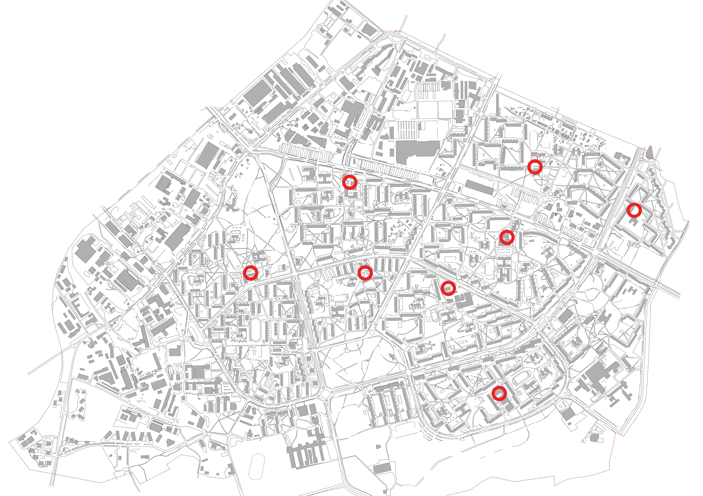
Existing ABC center locations

Slide 8
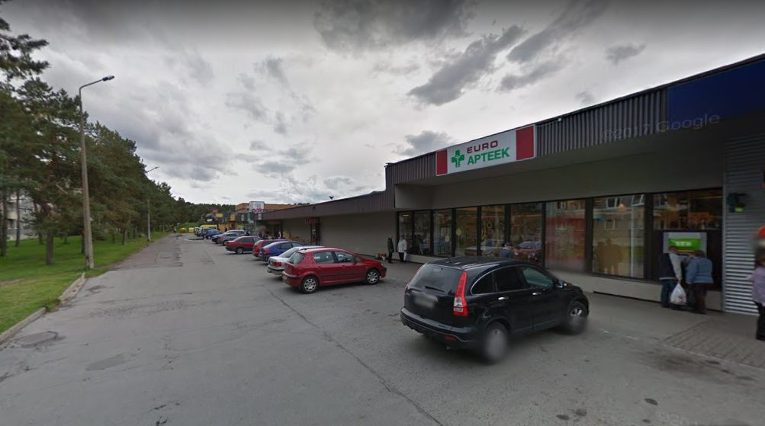
Current look

Slide 9
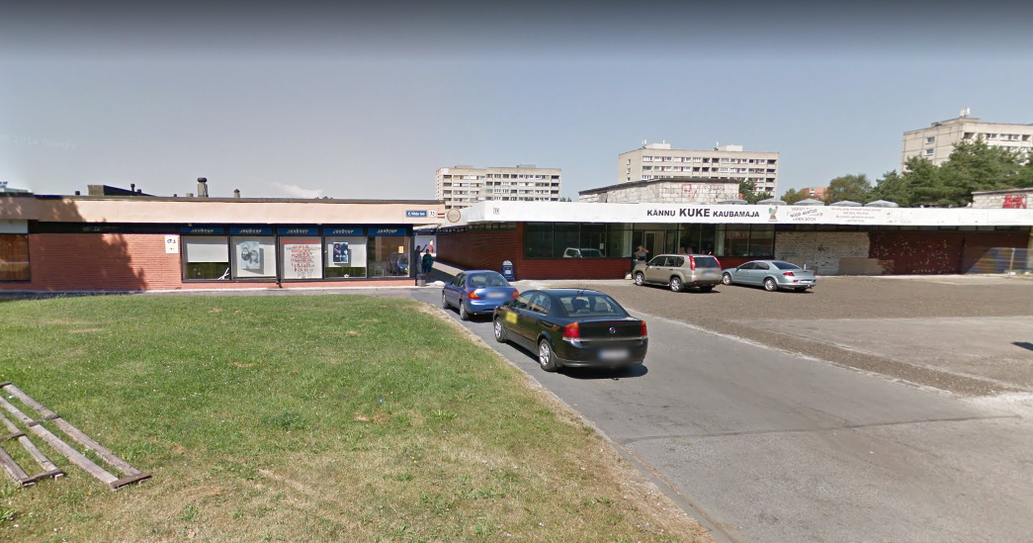
Current look

Slide 10
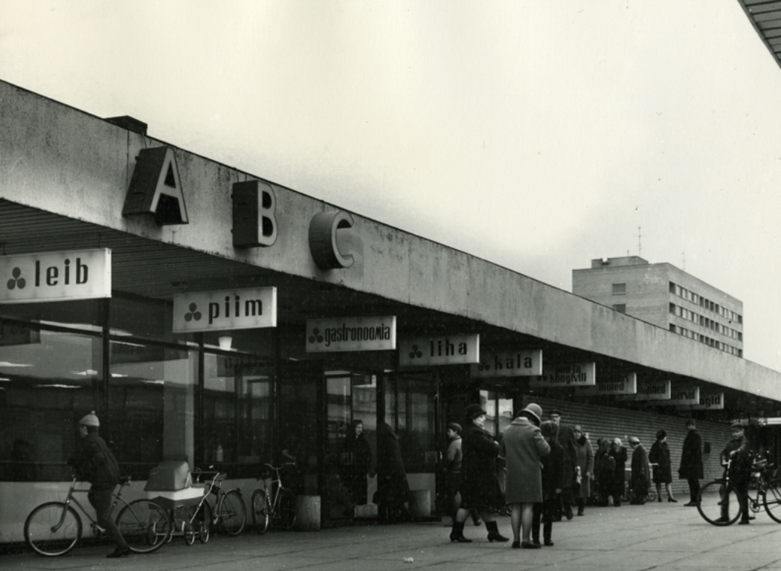
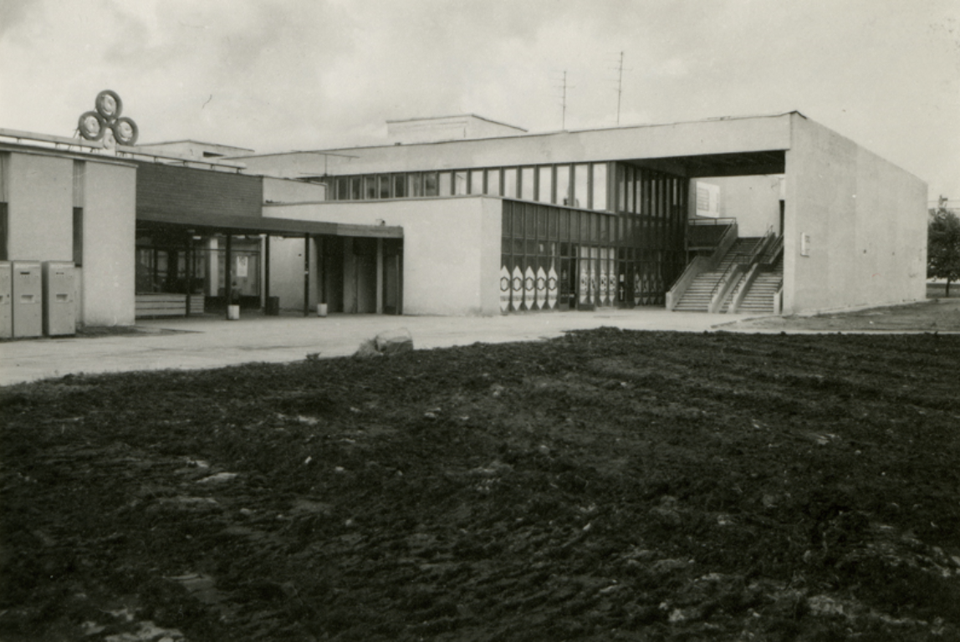

Slide 11
Example of placemaking solution
Copenhagen Superkilen area

Slide 12
Event ideas to activate citizens
Occasionally
Neighborhood cleaning day
Sharing activities (food, tools, books)
Music fest day
District festival day
Cinema screening
Hobby’s center
Regularly
Board-games
Community public living room
Centers based on age (children, youth, old)
Language cafes
Books exchange
Library corner

