Slide 1
How to increase citizen participation and promote co-creation to improve living
environment and quality of life?
How to connect local authority and (active) citizens?
TALLINN INNOVATION CAMP 2018

Slide 2
Context
Lasnamäe, (11 micro district)
Threats
Lack of identity
Bad image
Monofunctional district
Few social infrastructure
Car oriented
Opportunity
Active citizens
NGO
Basement shops
Local production
existing gathering places

Slide 3
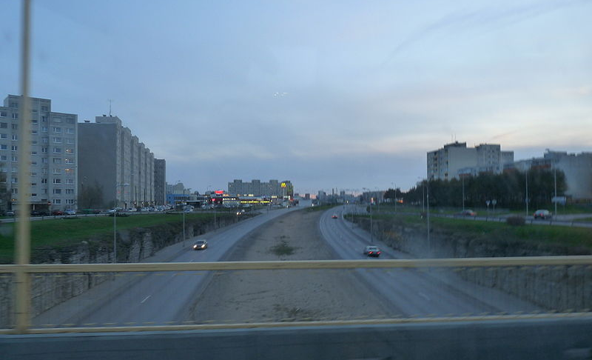
« - »

Slide 4
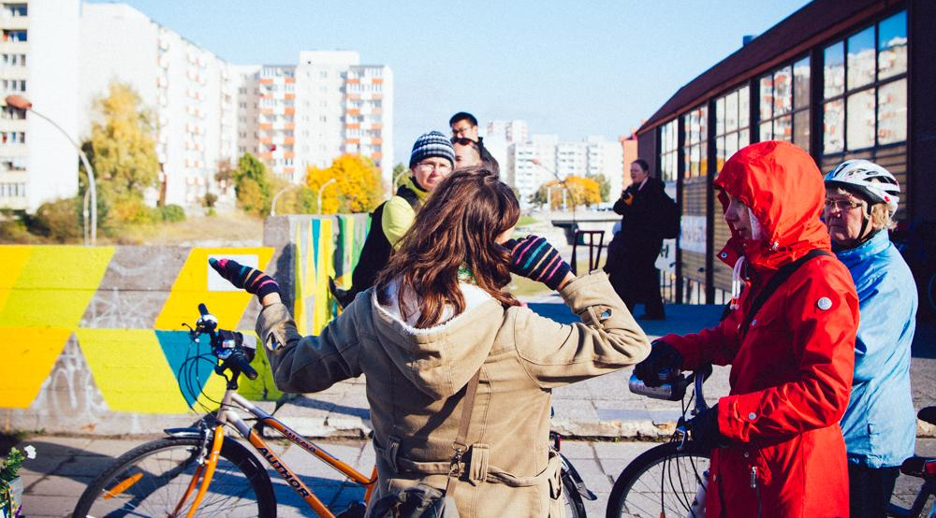
« + »

Slide 5
Challenge of co-creation process
1/ lack of awareness on both ends - searching for positive examples micro-districts identity
2/ lack of constructive dialogue between (active) citizens and municipality (moderatoration / coordination) 3/ lack of structure for collaboration

Slide 6
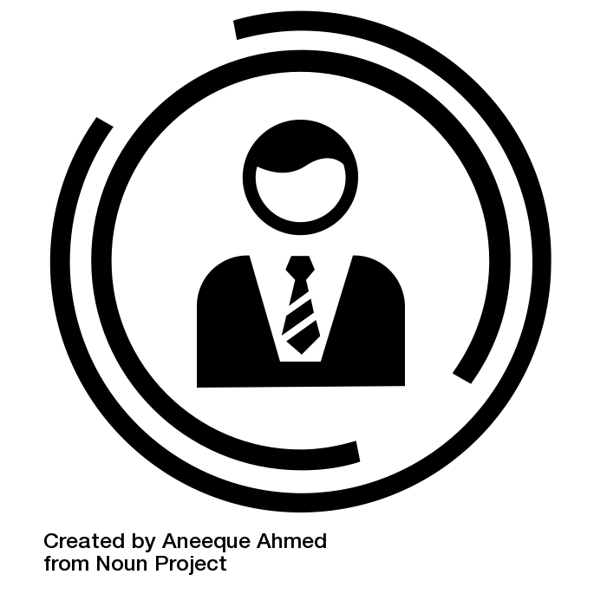
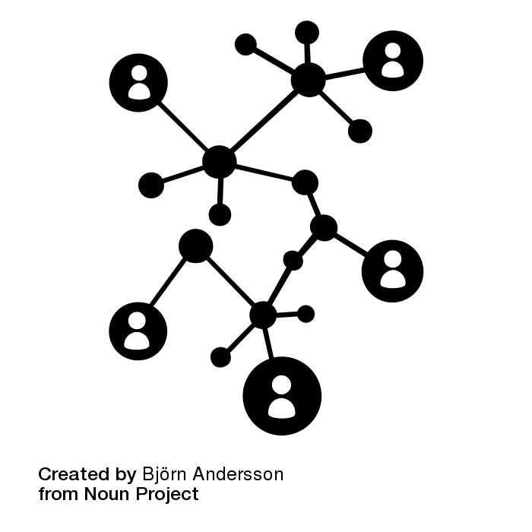
MODERATOR as change facilitator
Coordinated municipality
Empowerment citizen participation
Municipality
Community
Project management communication
Empowerment create them new
Participate
Intervention & dialog
Strategic project
Project manager
& core team

Slide 7
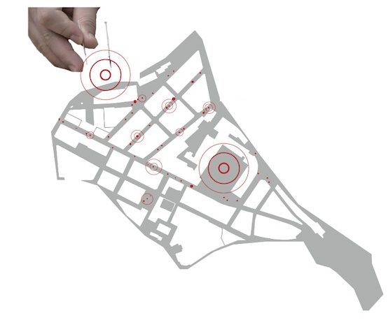
Big vision &
small interventions
small interventions
small interventions
small interventions
(tangible results) - combined process

Slide 8
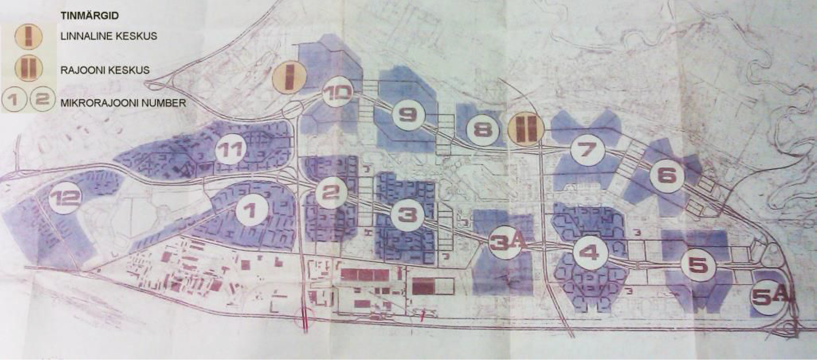

Slide 9
Process
2/ Phrasing a vision with municipality - big picture (choosing the focus area)
1/ Collection of existing best practices
communication program
news paper
brochures
online
podcasts (radio)
3/ Prototype in one micro-district

Slide 10
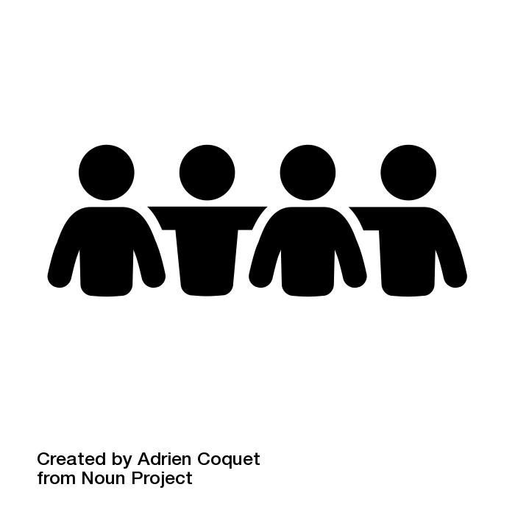
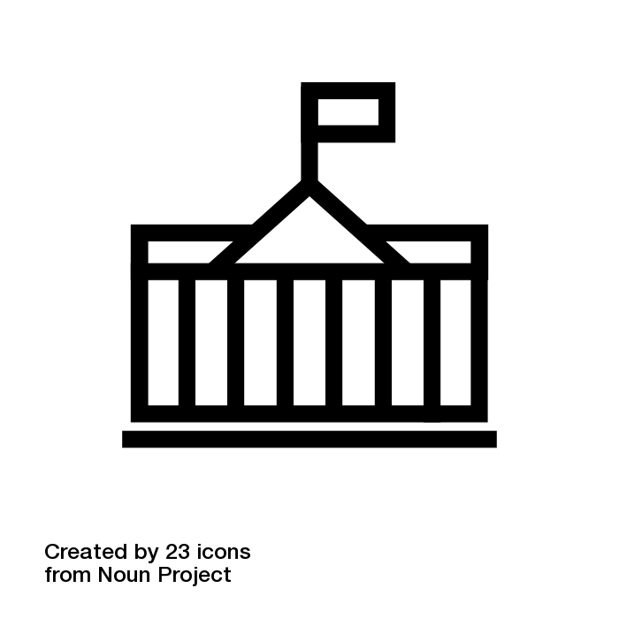
TimeLine
constant communication and PR with public!
interventions, prototyping
best examples
Co-creation - the new normal
participatory budget
Collaborative action plan
vision
strategic projects

Slide 11
Prototype (one micro-district)
Program of participative actions
World cafe
online feedback (impression from the area)
participatory budget
Interventions (creative workshop in public space: mosaic, painting, move nights, urban garden community cooking etc)

Slide 12
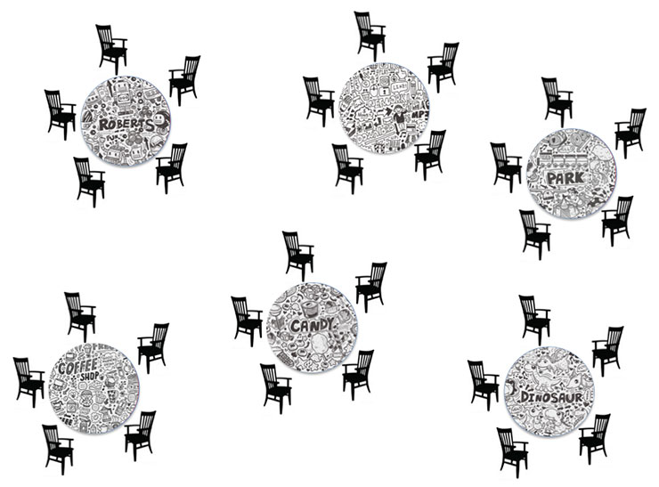
World cafe

Slide 13
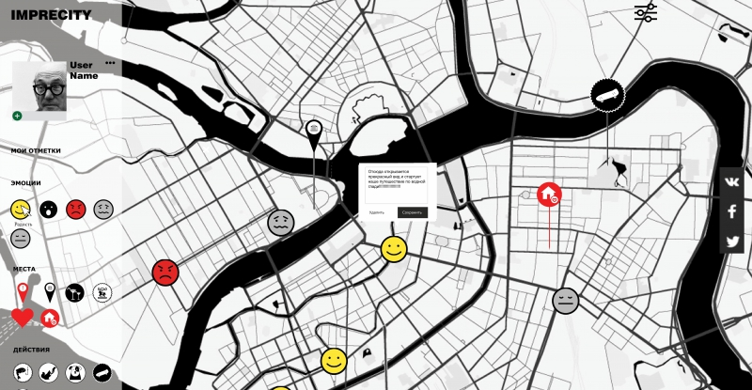
Online feedback (app imprecity.ru)

Slide 14
Participatory budget

Slide 15
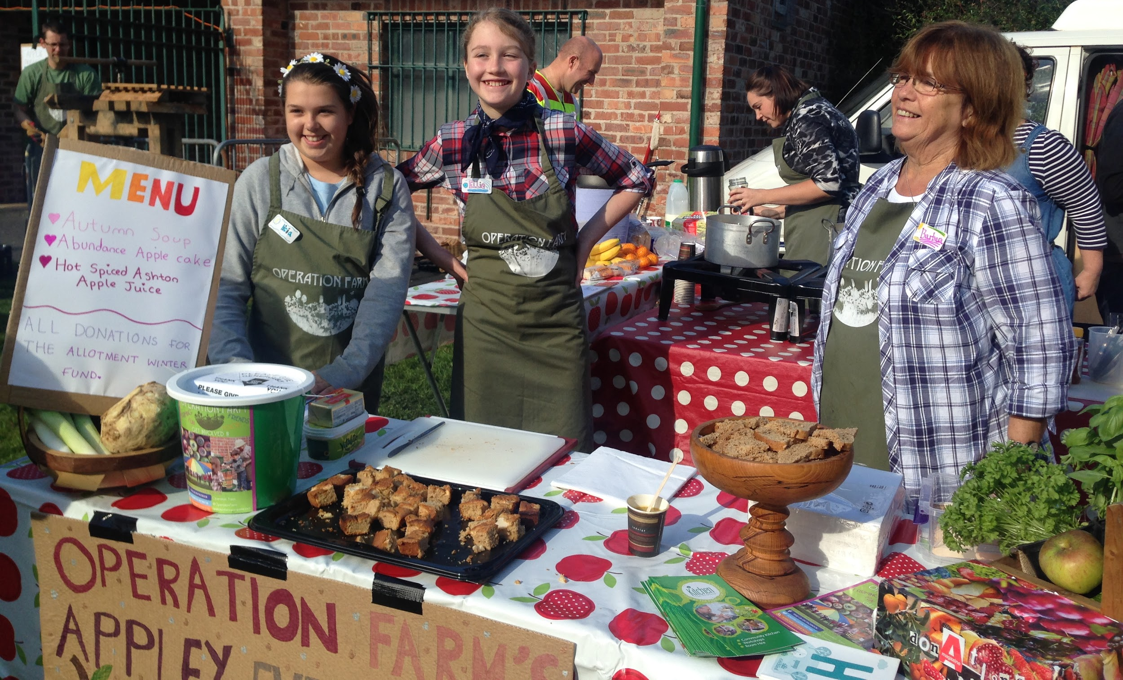
Interventions
Creative workshop in public space: mosaic, painting, move nights, urban garden community cooking etc)

Slide 16
Co-founder

Slide 17
Goals/ key messages
№1 PLACE IDENTITY/ NEIGHBORHOOD APPROTION
№2 CONSTRICTIVE DIALOG BETWEEN CITIZEN AND MUNICIPALITY

Slide 18
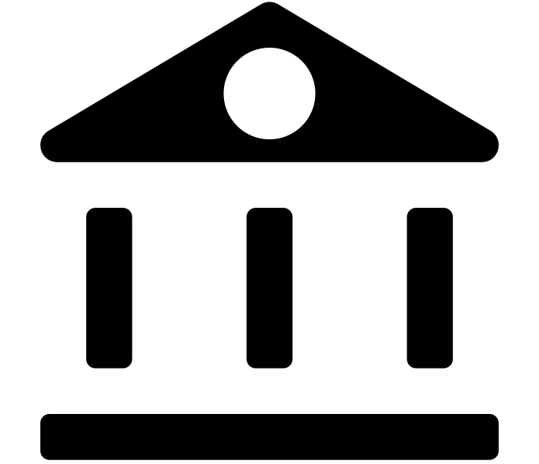
(Human) resources
NGO
Moderator
Municipality
Community
Institutions (school, library)

Slide 19
Co-funding
municipality
local businesses
residents (condos)
real-estate agencies
civil society foundations
transnational funding agencies ...
ministry (expand model on the state level)

Slide 20
Risks, Assumptions & the Unknown
? POSSIBLE PREFERENCES, HABITS, IMPRESSION
? LACK OF TRUST BETWEEN ALL ACTORS
? LACK OF ENTHUSIASM FROM MUNICIPALITY
? NO MONEY, NO HONEY
? LACK OF CONTINUITY IN HUMAN RESOURCES
? FLEXIBILITY IN PROTOTYPING (LESS RISKS IN CASE OF FAILURE)
!
!

