Slide 1
City aid
How to make the city digital with the help of artificial intelligence and co-creation?

Slide 2
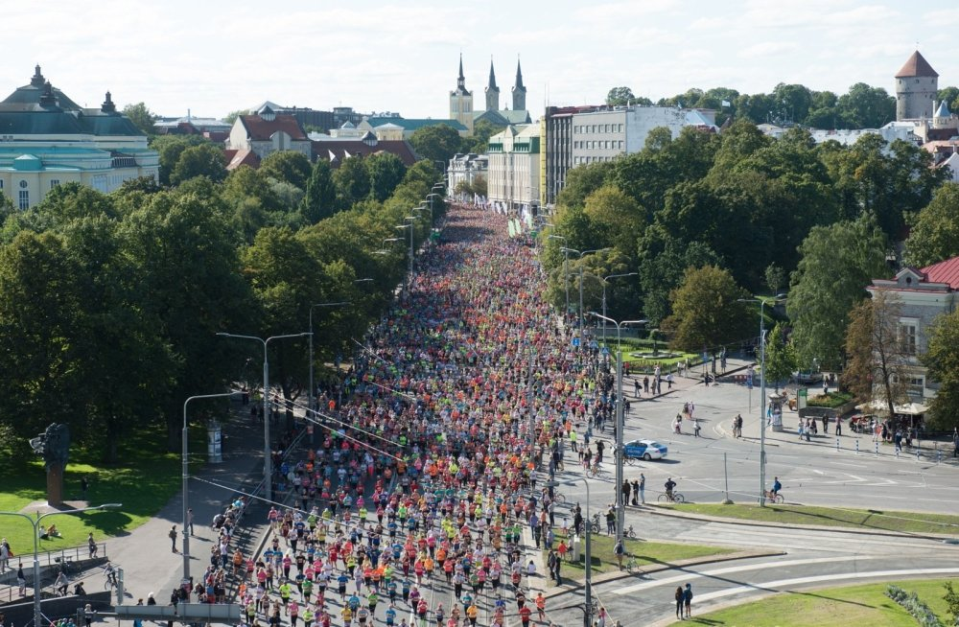

Slide 3
Key message
  Synchronizing movements of traffic / people to avoid congestions

Slide 4
actions
Interoperability between authorities responsible for traffic
Inclusion of AI
Real time and predictive management of the flow of traffic and people

Slide 5
Achievements
Time saving
Cost saving
Avoid congestion
Flow management
Less stress
improve citizens life
increase business activities
Avoid surprises

Slide 6
stakeholders
City transport department (Tallinna Transpordiamet)
Utilities Department (Tallinna Kommunaalamet)
City Enterprise Department (Tallinna Ettevotlusamet)
Tallinn City Tourist Office (Tallinna Ettevotlusameti turismiosakond)
City Regional department - central (Tallinna Kesklinnavalitsus)
Urban planning (Tallinna Linnaplaneerimise amet)
Police department
Event organizers
Participants

Slide 7
Roadmap – 6 weeks
Analyse current situation
Data identification
Combine data
Initial concept

Slide 8
Roadmap – 6 months
Obtain ai prototype
Data feeding
Expand data sources & inputs

Slide 9
Roadmap – 6 years
Real time and predictive ai
Implementation in other cities and countries

Slide 10
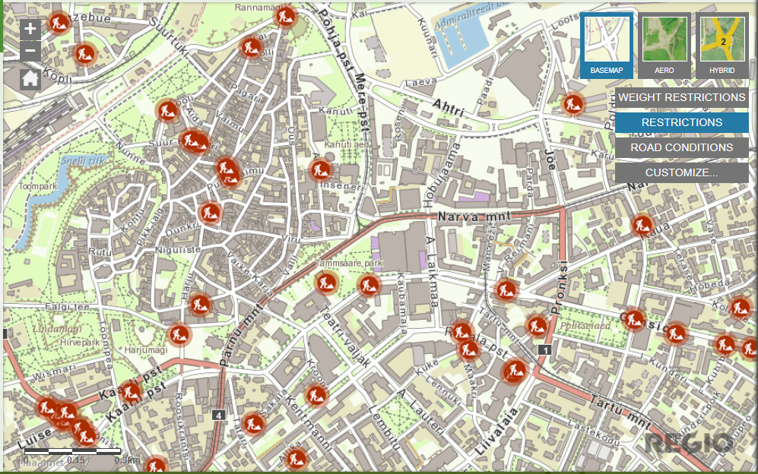
City aid

Slide 11
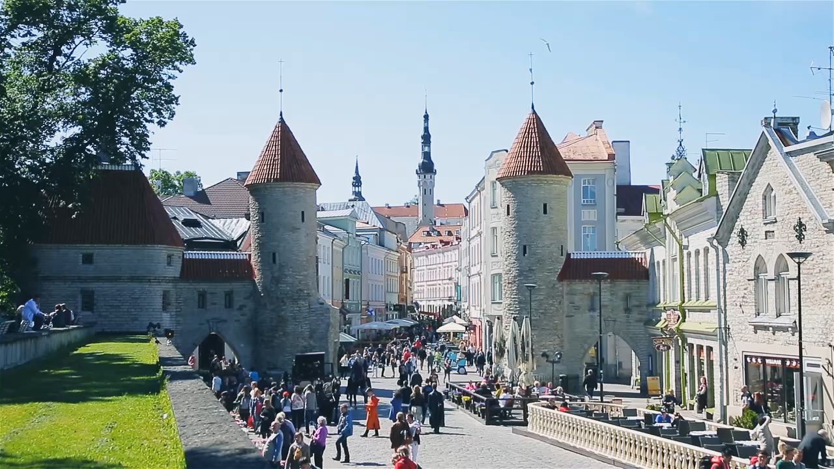

Slide 12
THANK YOU!

Slide 13
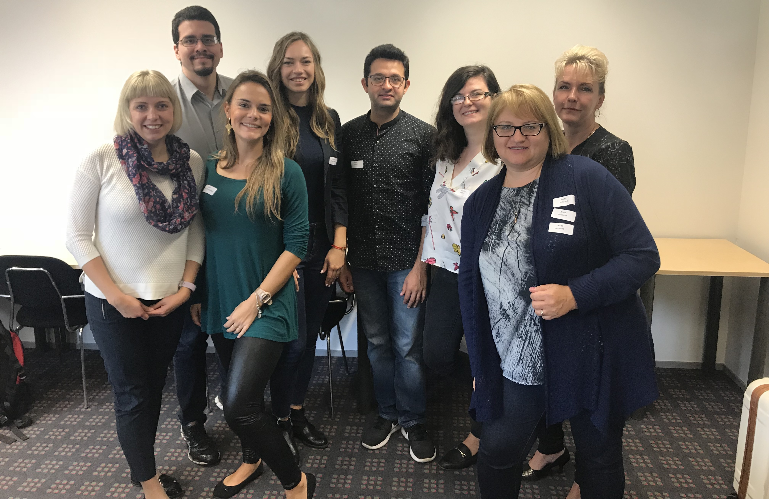
THANK YOU!

