Slide 1
Project name Agora/ Trigger Point
Group 5/ Challenge 2

Slide 2
Specific problem:
The appartment housing management and inhabitants are not knowledgable enough about how to improve their living environment and conditions and the legislation and rules to that need to be followed.
Context:
Lack of consise, understandable information on themes like living environment improvement, etc., is affecting the motivation of inhabitants to create change and creating connectivity issues between the stakeholders.

Slide 3
Solution
Digtal knowledge platform based on collaboration, networking, multi-level governance to support inhabitants and the society, and to create synergies between different stakeholders
Supporting libraries as knowledge centres and creating a link between the digital platform and stakeholders

Slide 4
Key phrase/main value:
Triggering the change and bringing planning and decision making closer to the inhabitants of the districts
Boosting interpreneurial mindset in the district societys

Slide 5
Opportunities/desired autcome:
Educating appartment union (AU) managers and leaders, so they can motivate the inhabitants by explaining, organizing the change, helping to climb the ladder to improved living conditions;
AU managers become mediators between the inhabitants and the municipality;
Increase of focused, transparrent housing and district improvement projects;
Collected data about novelties and improvement costs of appartment housing and their surrounding area (thick data/big data);
Showcasing positive novelties, learning from examples;
Building a communication network between the AU managers and municipality, vice versa;
Allowing the inhabitants to give feedback for received services;
Created business opportunities.

Slide 6
Who benefits/ Stakeholders:
Estonian and russian speaking inhabitants of the districts and appartment buildings;
Residents who are not citizens of Estonia (e.g. global talent living and working here);
Union of appartment housing managers;
Service providers and businesses;
Municipalities

Slide 7
Risks, Assumptions & Unknown:
Lack of motivation in the targeted group;
Different level of participation;
Knowledge platform content relevance;
Rules and legislation of creating content and future input;
The design of the platform might not suit to various age and interest groups;
Sustainability of the platform – relevance of the information, technology maintenance, profit and financing scheme;
Limited resources to create and addapt to the platform;
Unintended consequences, e.g.competition amongst the neighbourhood.

Slide 8
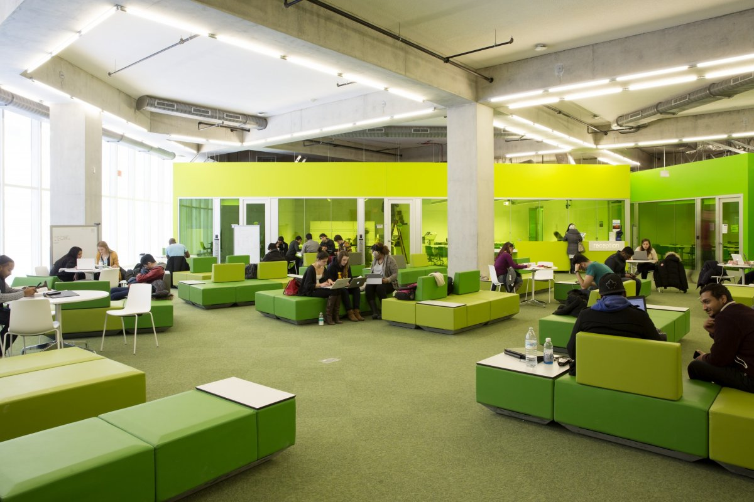
Resources:
Experience of the target group;
Experience and knowledge of the AU managers;
Digital tool developers, skilled professionals;
Participation of municipalities and co-financing to develop the digital, knowledge platform «Agora/Trigger point»;
Municipality created focus groups: information gathering, evaluating;
Creative hub/physical meeting placefor the creators of the knowledge platform
... .

Slide 9
Action plan
6 weeks:
The municipality of Tallin city – main leader;
Reaching consensus about the participants:municipalities;
Creating work plan: estimating deadlines, financial costs, seting up rules and principles.
6 months:
Approaching the AU managers and activists, introducing to the idea, asking for feedback, gathering information;
Organizing a hackathon event focused on writing the code and building the platform (Mektory);
Identifying the content of the «starter kit» (first basic info in the platform).
6 years:
Testing and learning from users experiences;
Monitoring and evaluating;
Linking business opportunities with the platform and neighbourhoods needs,
Seeking for possible business models;
Developing new content from the thick/big data.

